Slide 1
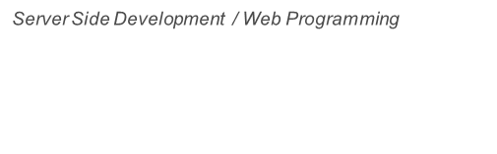


Four pillars of OOP
Style

Slide 2









Encapsulation
Abstraction
Inheritance
Polymorphism

Slide 3

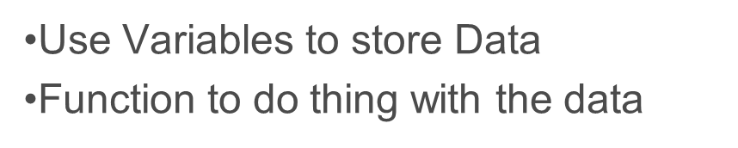
Procedural Programming
Function and Variables

Slide 4
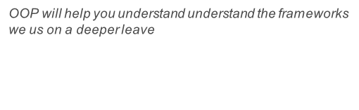

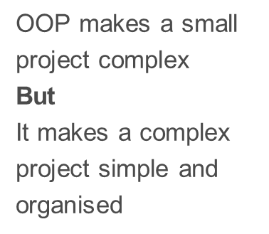
“
OOP
VS
Procedural

Slide 5
Procedural
Procedural works well for small projects
func()
func()
func()

Slide 6
Procedural
func()
Procedural is not best
practice for large projects
func()
func()
func()
func()
func()
func()

Slide 7
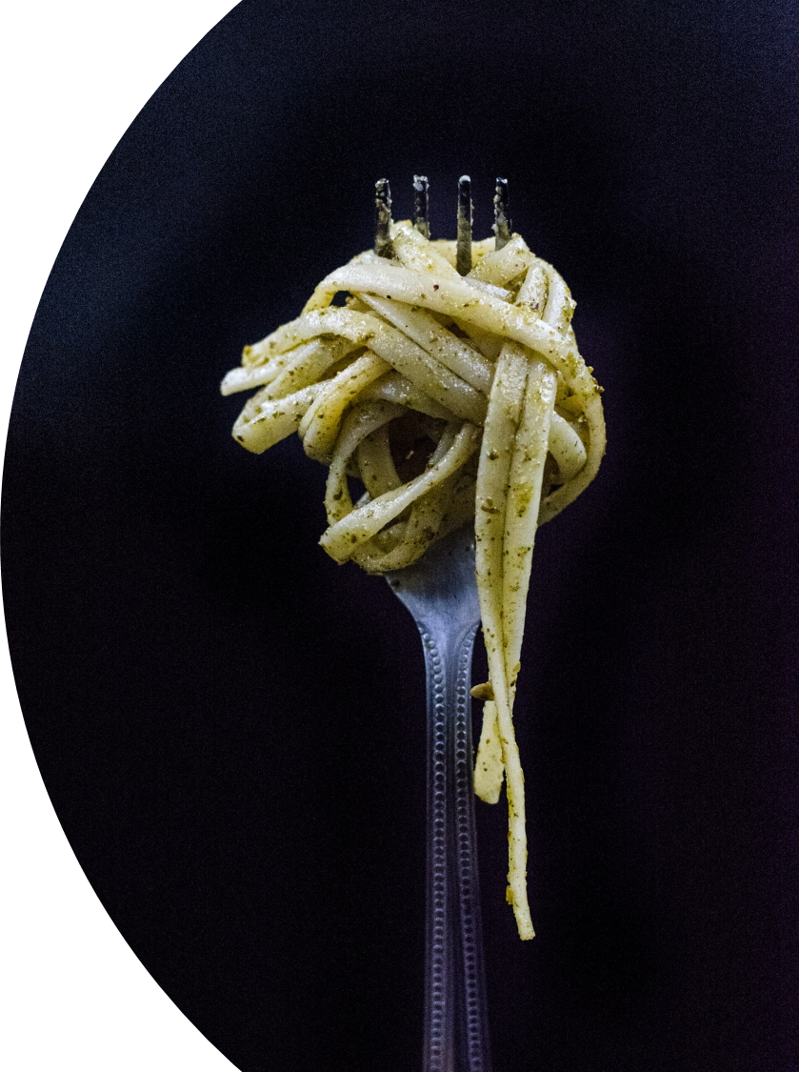
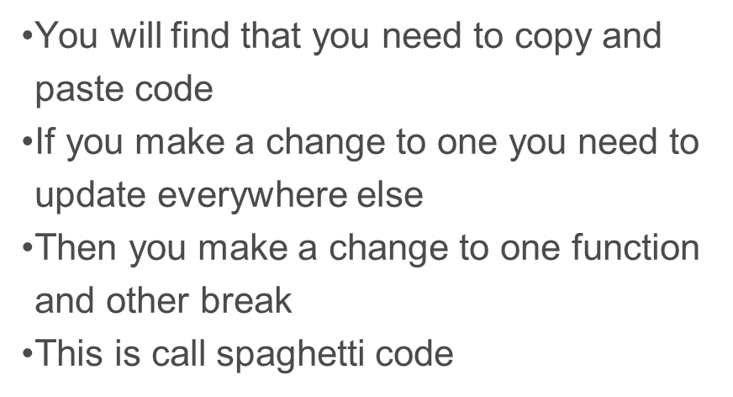
Procedural Programming
Large Projects

Slide 8
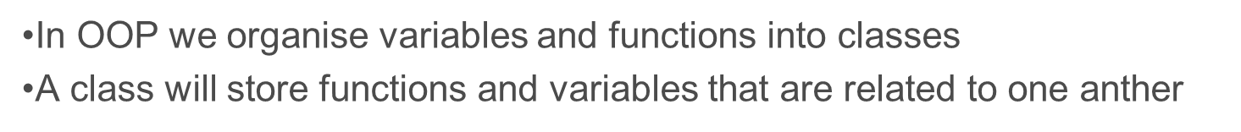
OOP
Class
Class
Var
func()
Var
func()
Property
Methods

Slide 9
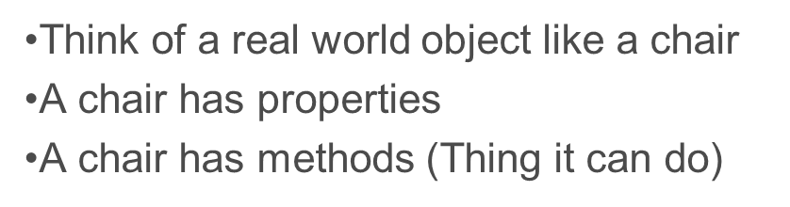
Classes are like objects
Chair Class
Var
Colour = Blue
Make = Office Chair
Height = 90cm
func()
Role()
Turn()
AdjustHeight()

Slide 10

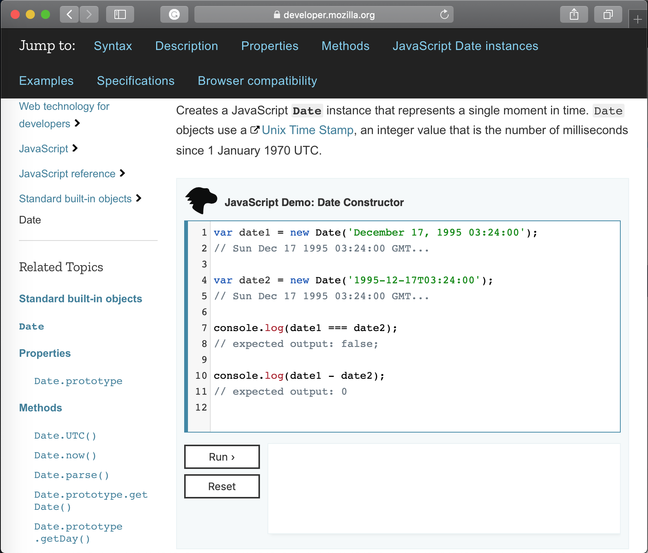
Date Object

Slide 11

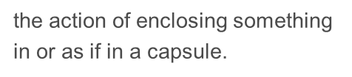

Encapsulation
Encapsulation

Slide 12
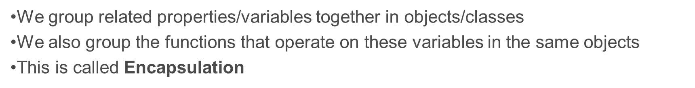
Encapsulation
Class
Var
func()
Property
Methods

Slide 13
Encapsulation Example
var costOfItem = 50;
var tax = 10;
function taxCal(costOfItem, tax) {
return costOfItem + (costOfItem / 100 * tax); // $5
}
taxCal(costOfItem, tax);
Procedural
Programming
var taxCalculator = {
costOfItem: 50,
tax: 10,
addTax: function() {
return this.costOfItem + (this.costOfItem / 100 * this.tax); // $5
}
};
taxCalculator.addTax();
OOP
Programming

Slide 14

Encapsulation Example
var costOfItem = 50;
var tax = 10;
function taxCal(costOfItem, tax) {
return costOfItem + (costOfItem / 100 * tax); // $5
}
taxCal(costOfItem, tax);
Procedural
Programming
var taxCalculator = {
costOfItem: 50,
tax: 10,
addTax: function() {
return this.costOfItem + (this.costOfItem / 100 * this.tax); // $5
}
};
taxCalculator.addTax();
OOP
Programming
Notice no arguments
As the code is tightly coupled, we do not need them
The best functions have no parameters
As there is less that can go wrong when we update code

Slide 15

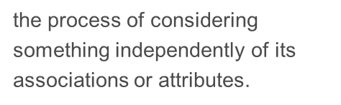
Abstraction
Abstraction

Slide 16

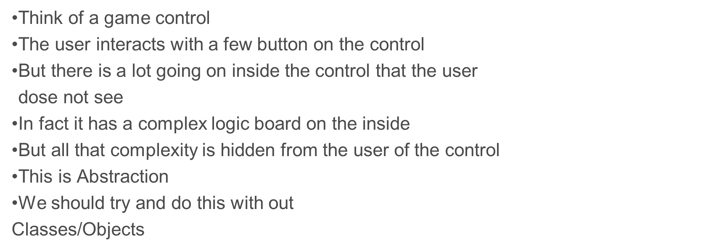
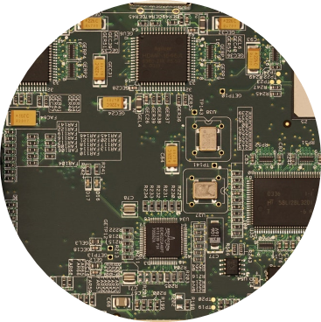
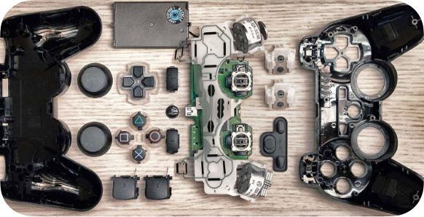
Abstraction Example

Slide 17
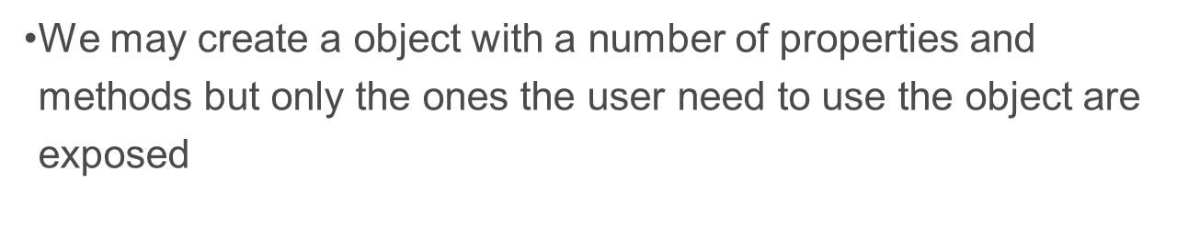
Abstraction
Object
Var
func()
Var
func()
Var
func()
Var
func()

Slide 18
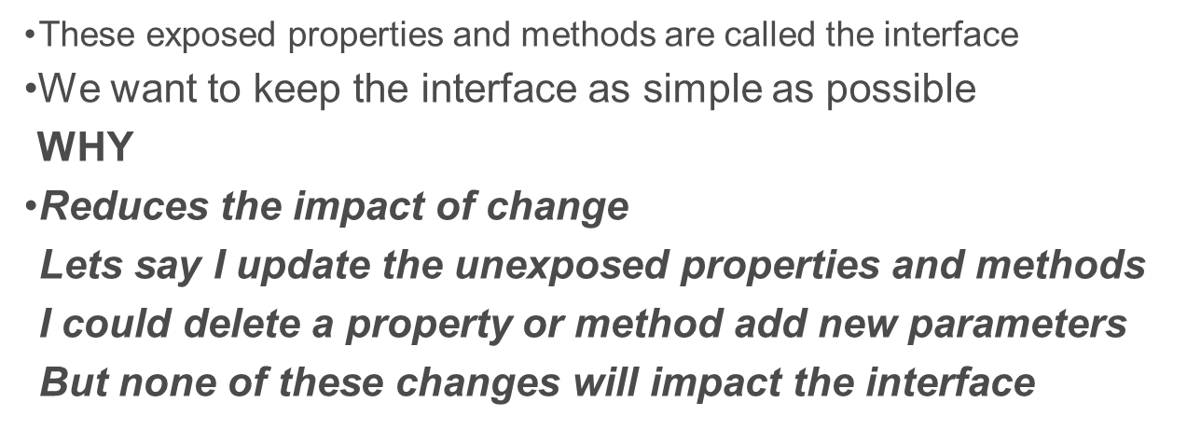
Abstraction
Object
Var
func()
Var
func()
Var
func()
Abstraction reduces the impact of change
Var
func()

Slide 19

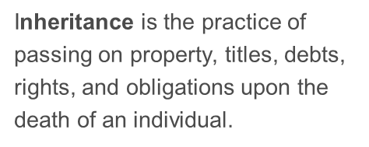

Inheritance
Inheritance

Slide 20

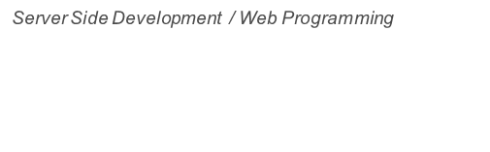
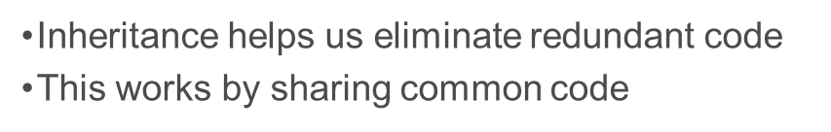

Inheritance
Parent Class
parentVariable
ParentMethod()
Child Class
parentVariable
ParentMethod()
childVariable

Slide 21
Inheritance
Parent Class
speed
Move()
Child Class
speed
Move()
childVariable
childMethod()

Slide 22
Inheritance
Intelligent Life Form Class
Move()
IntelligentLifeForm Features
Enemy Class
Player Class
Move()
IntelligentLifeForm Features
IntelligentLifeForm Features
Patrol()
Enemy Features
Player Features
Spider Class
Chewy Class
Move()
IntelligentLifeForm Features
IntelligentLifeForm Features
Move()
Patrol()
Enemy Features
Enemy Features
Patrol()
Spider Attack()
Spider Features
Chewy Features
Chewy Attack()

Slide 23
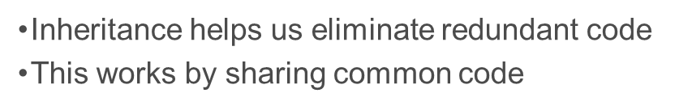
Inheritance
HTML Element
hidden
innerHTML
click()
focus()
Check Box
Drop Down
hidden
innerHTML
click()
focus()
hidden
innerHTML
click()
focus()
checked
ListOf Items
DisplayList()

Slide 24

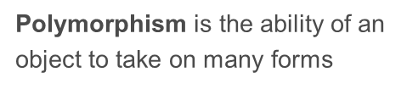

Polymorphism
Polymorphism

Slide 25
Poly morphism
Many
Form
Polymorphism

Slide 26
Polymorphism
Within an inheritance hierarchy any child class can be said to be a parent class.
Enemy Class
Parent Class
Child Class = Parent Class
Spider Class
Chewy Class

Slide 27
Polymorphism
Within an inheritance hierarchy any child class can be said to be a parent class.
List
Datatype = Spider
Spider one
Spider two
Spider three
Spider four
List
Datatype = Chewy
Chewy one
Chewy two
Chewy three
Chewy four
Or
List
Datatype = Enemy
Chewy one
Chewy two
Chewy three
Chewy four
Spider one
Spider two
Spider three
Spider four
Intelligent Life Form Class
Enemy Class
Player Class
Spider Class
Chewy Class

Slide 28


Polymorphism
Within an inheritance hierarchy any child class can be said to be a parent class.
Child Class
Parent Class
=
Spider Class
Enemy Class
Parent Class
Child Class
=
Enemy Class
Spider Class

Slide 29
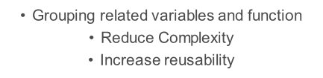
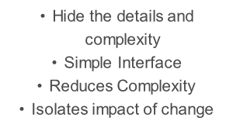

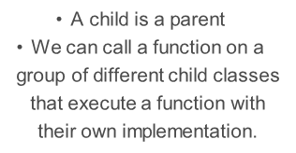
Encapsulation
Abstraction
Inheritance
Polymorphism

